Slide 1


Green must be convenient
Roberto Freato Azure MVP / Author / CTO @Retex

Slide 2


Join at slido.com #1037166
ⓘ Start presenting to display the joining instructions on this slide.

Slide 3
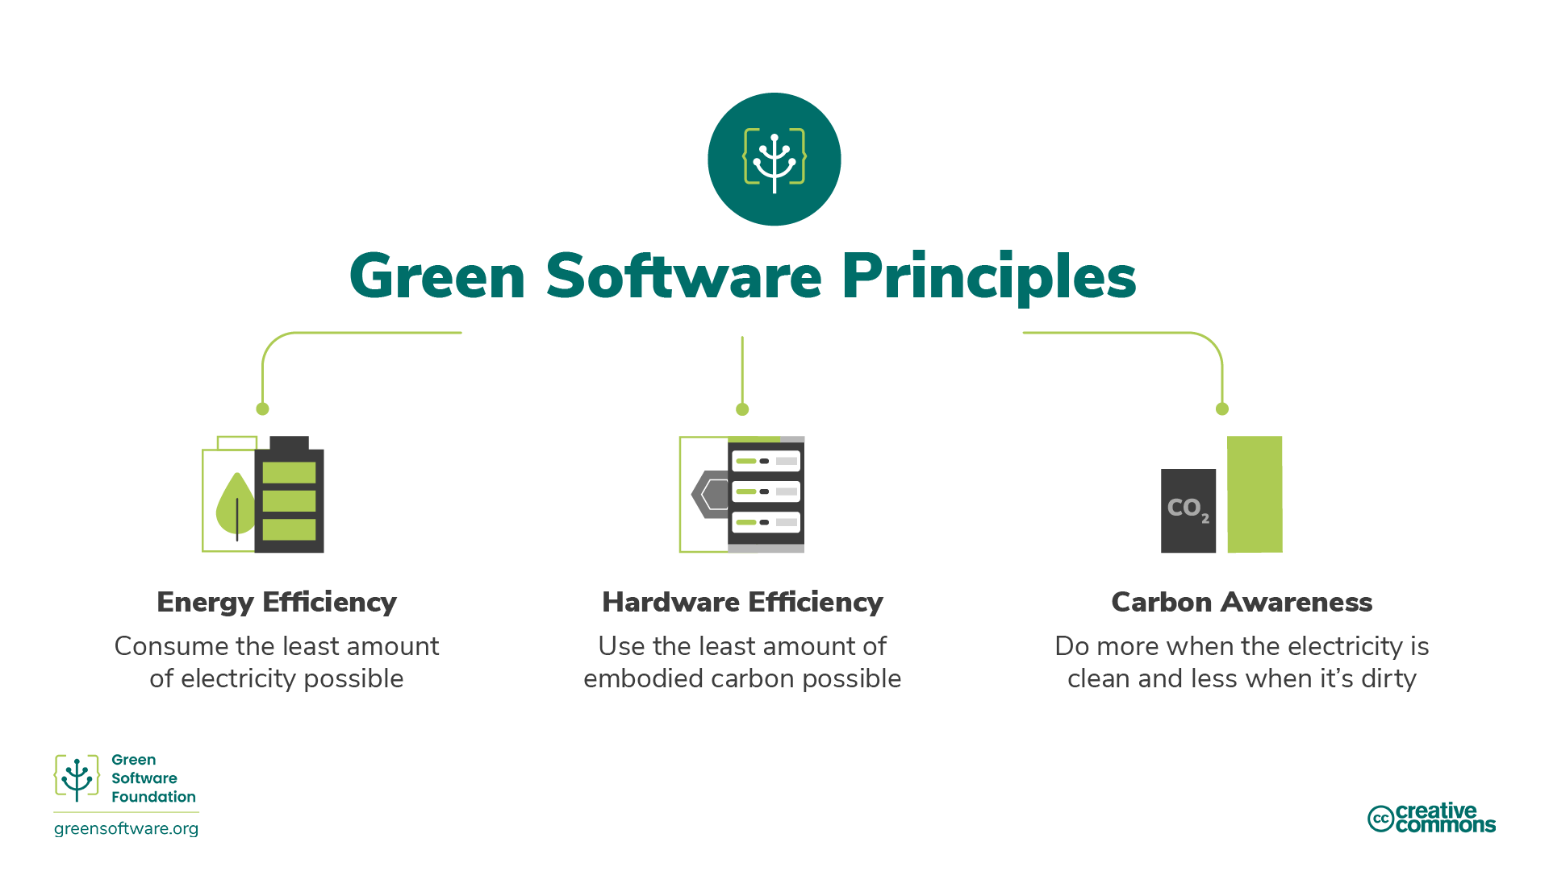

Slide 4
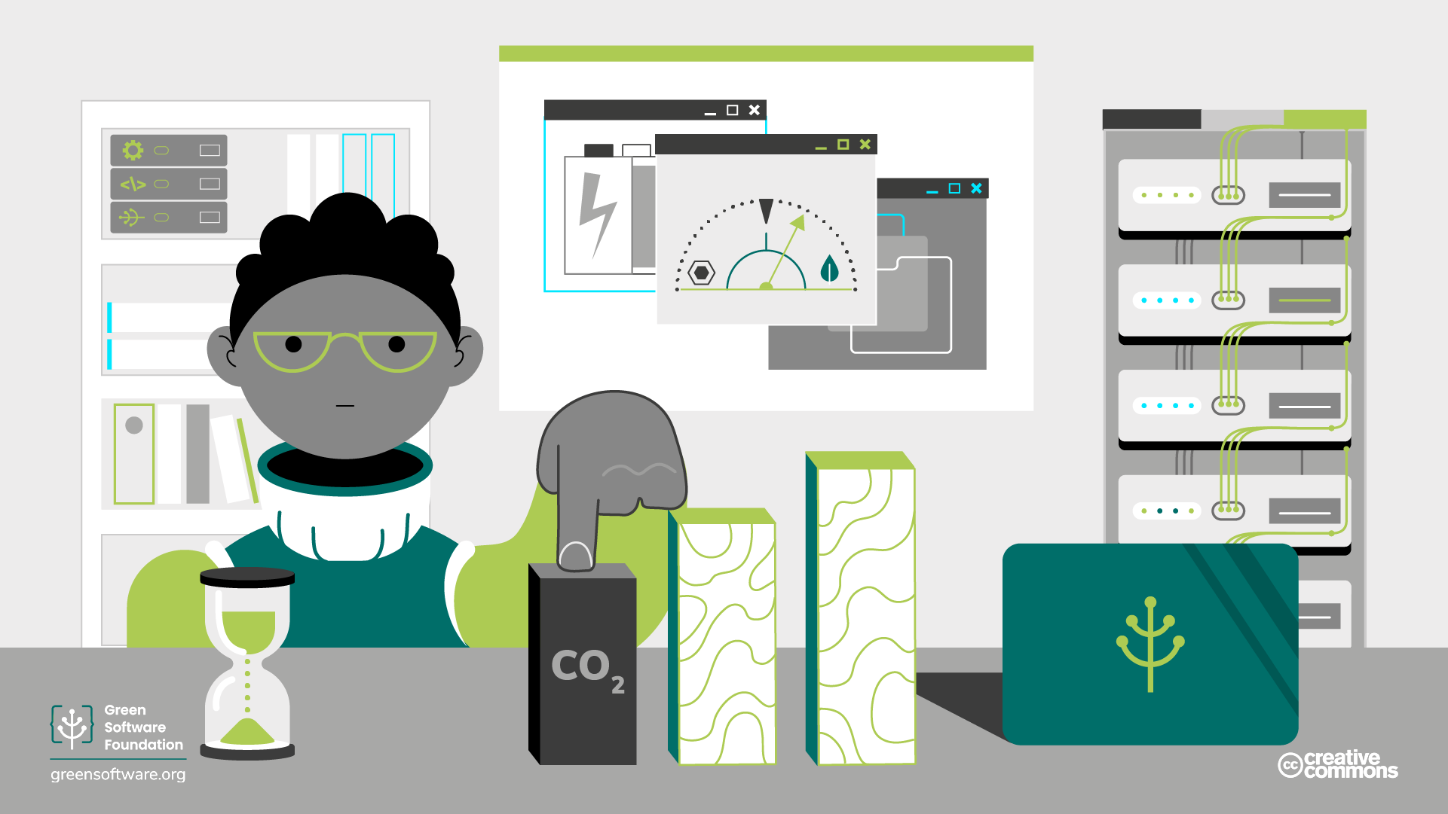
Carbon and CO2eq

Slide 5
Energy Efficiency

Slide 6
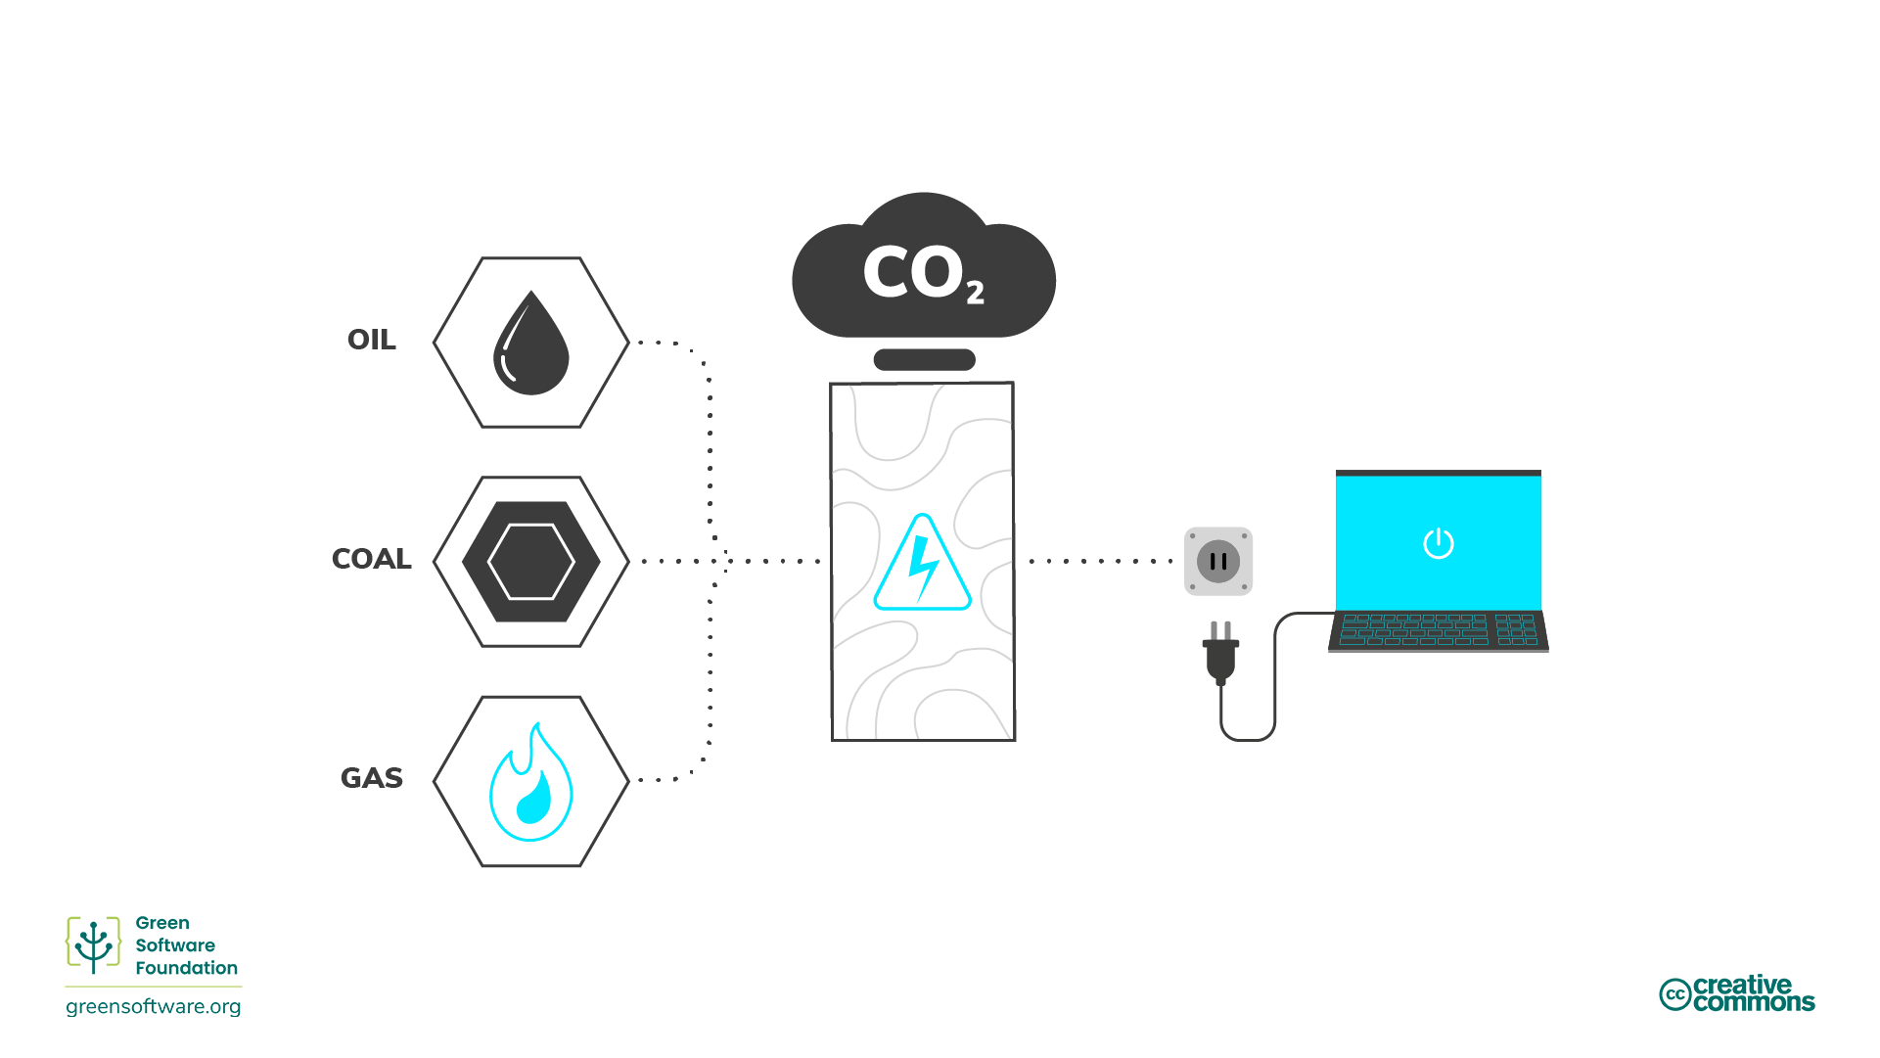

Slide 7
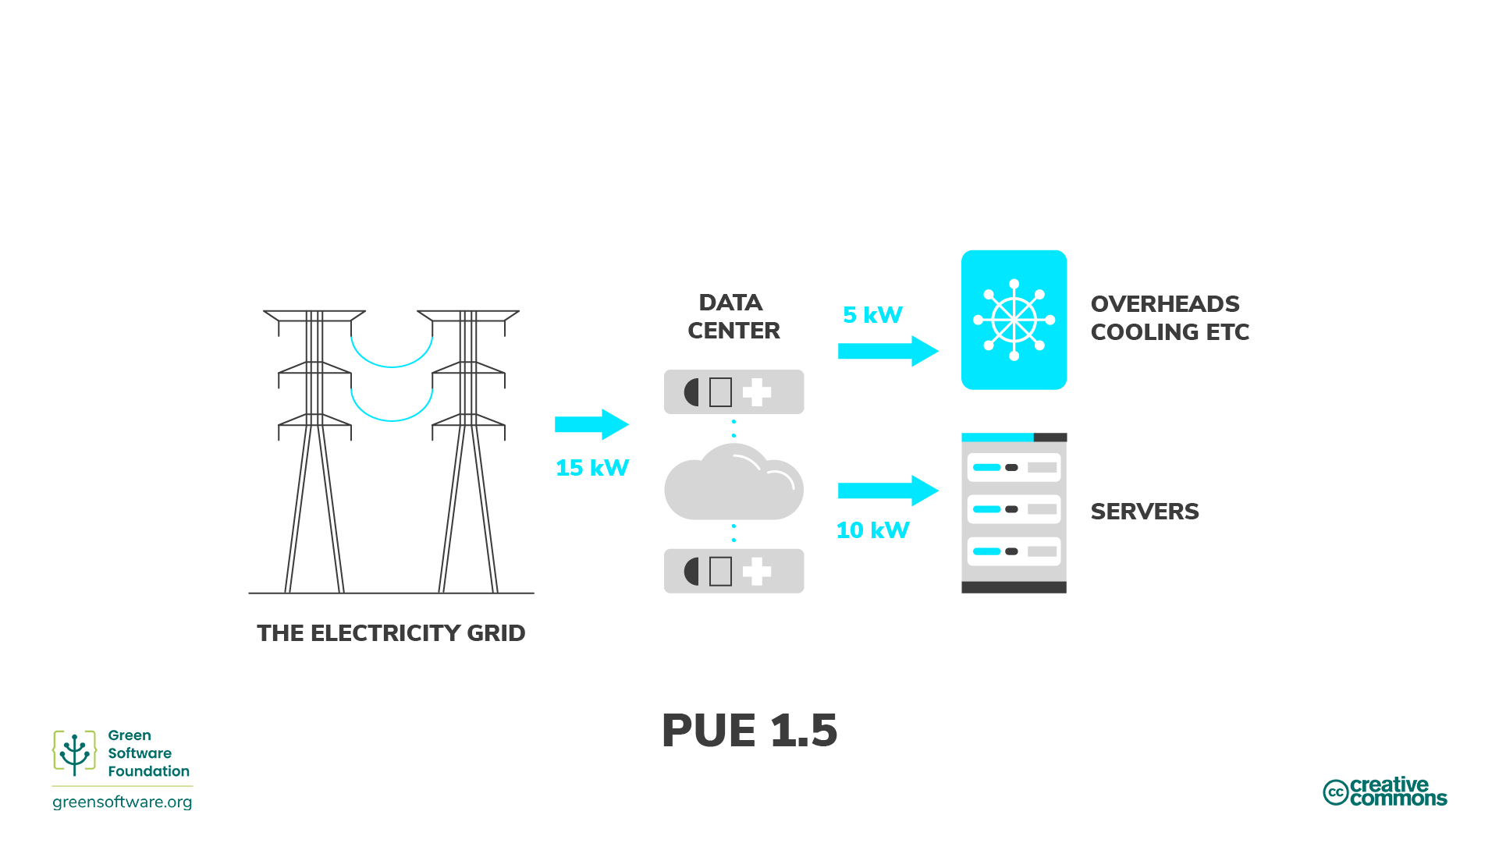

Slide 8
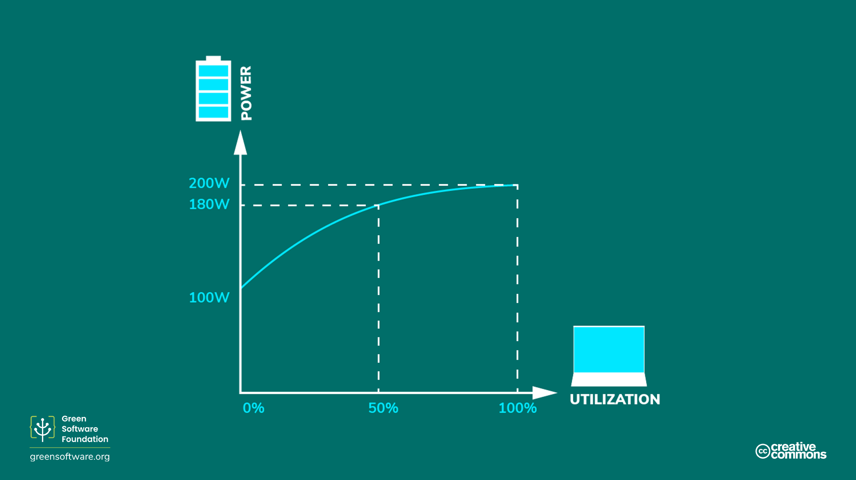

Slide 9

Which application consumes the most energy?
ⓘ Start presenting to display the poll results on this slide.

Slide 10
Hardware Efficiency

Slide 11
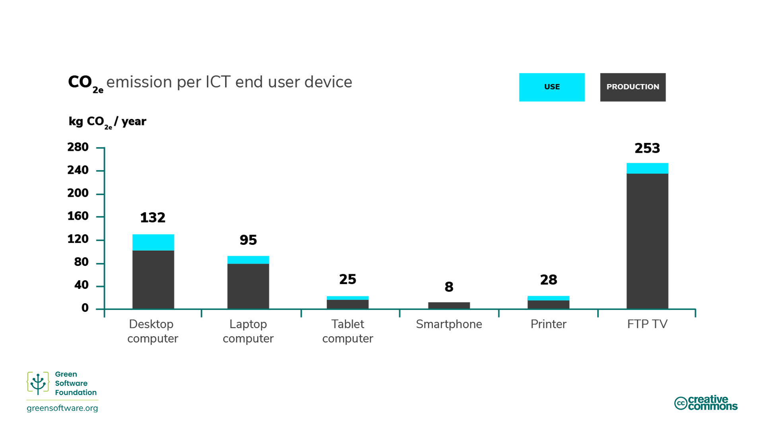

Slide 12
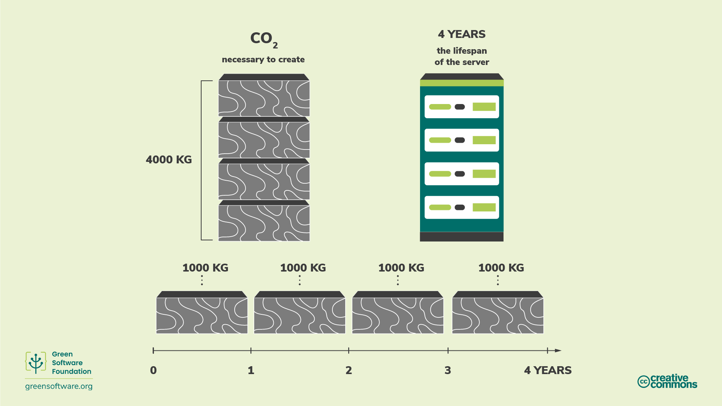

Slide 13
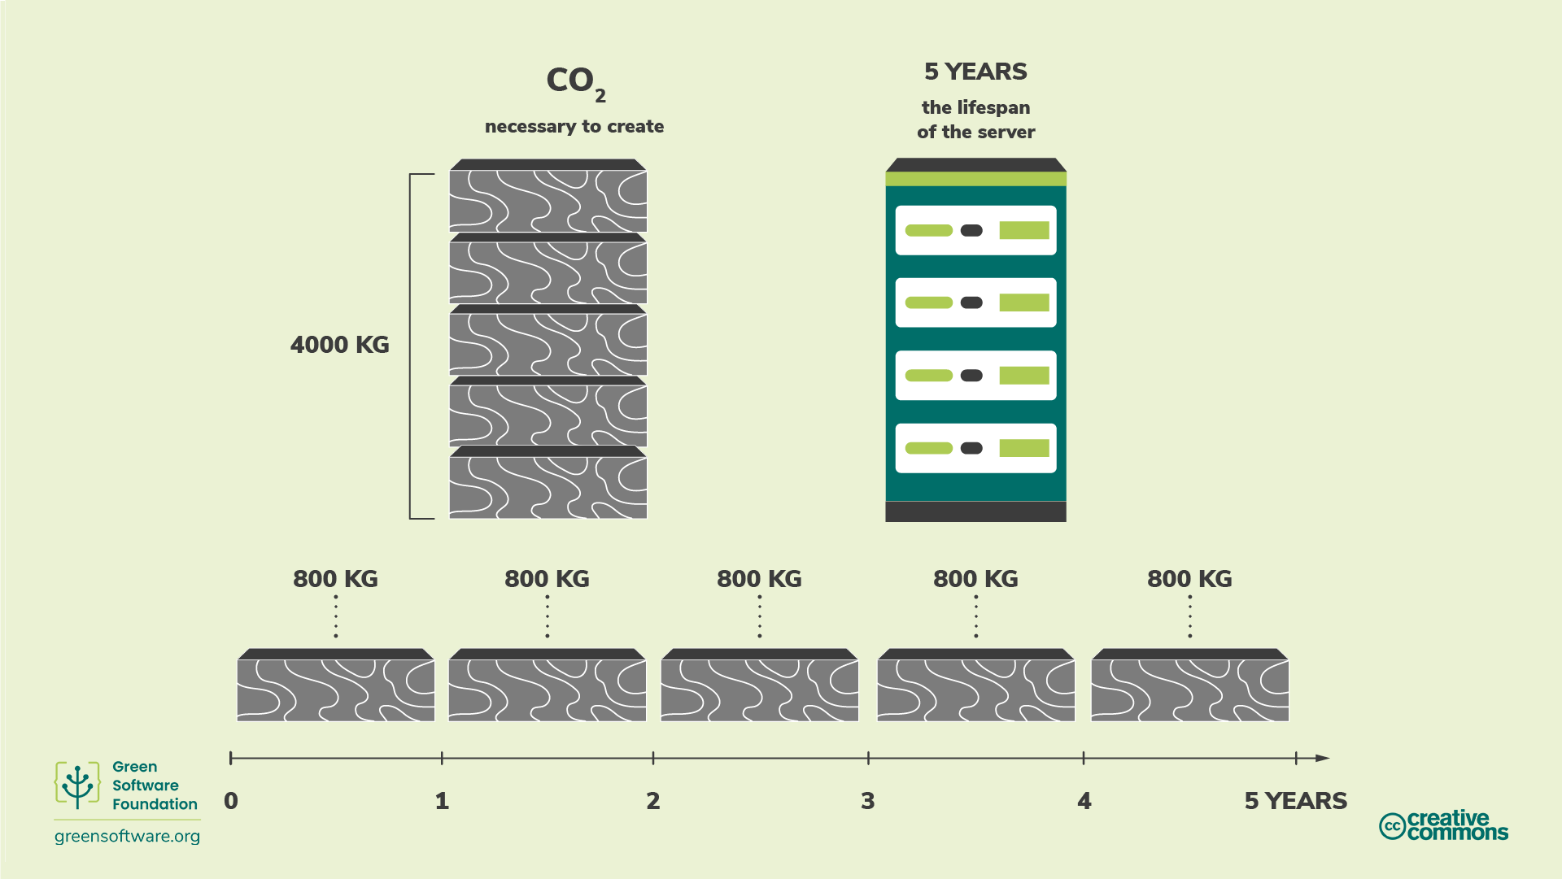

Slide 14
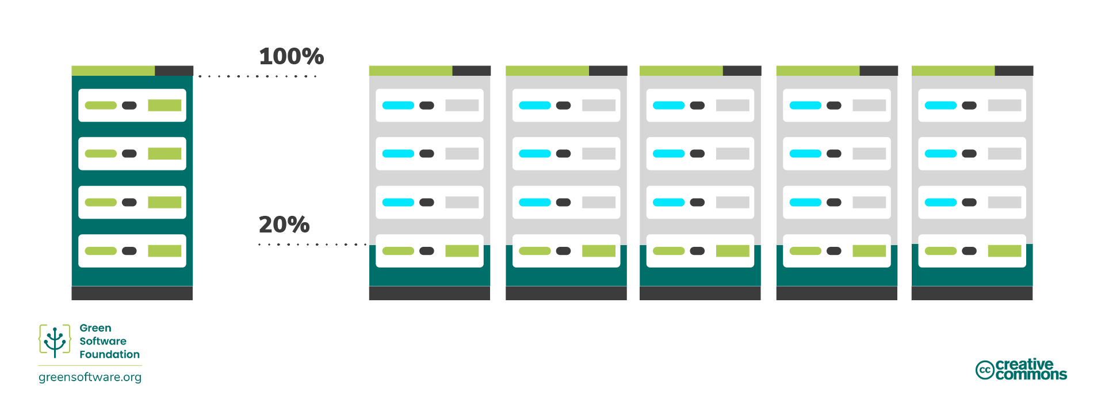
Increase device utilization

Slide 15
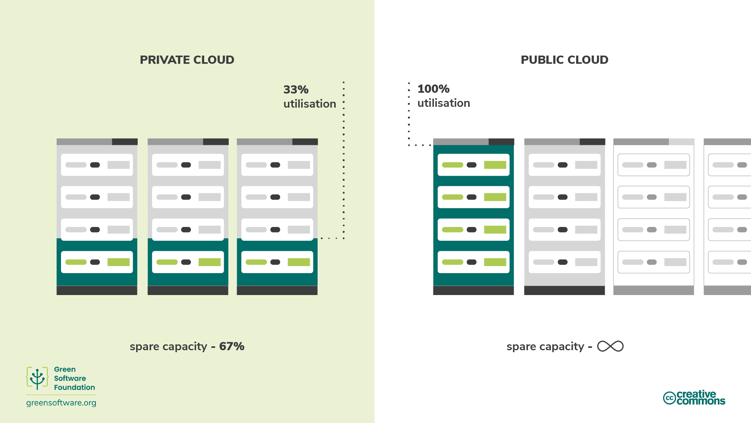

Slide 16
Why is it so important to include embodied carbon when calculating emissions for hardware?
ⓘ Start presenting to display the poll results on this slide.

Slide 17
Carbon Awareness

Slide 18
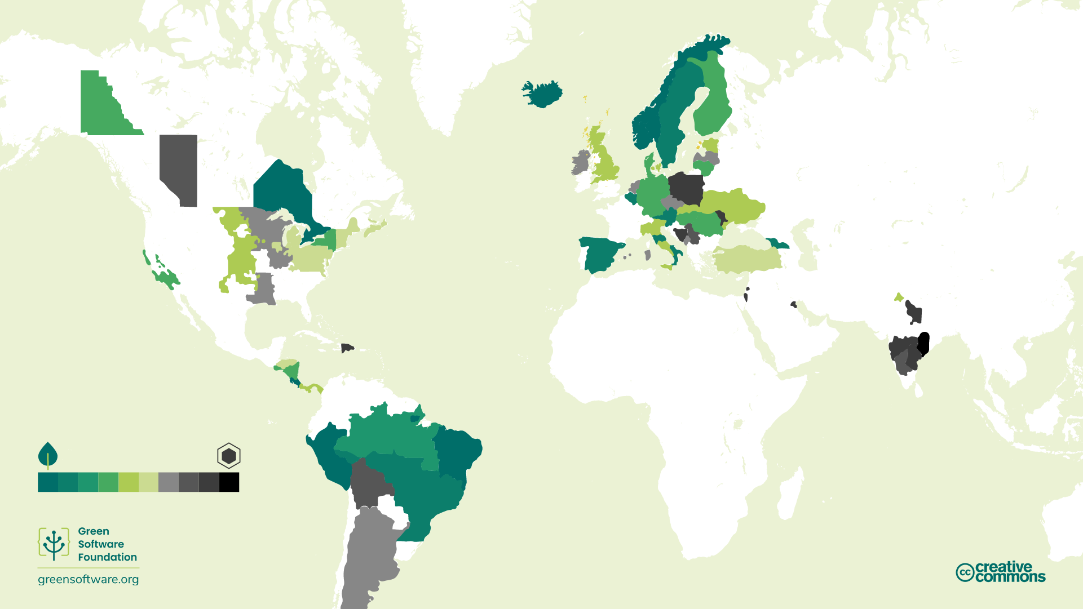

Slide 19
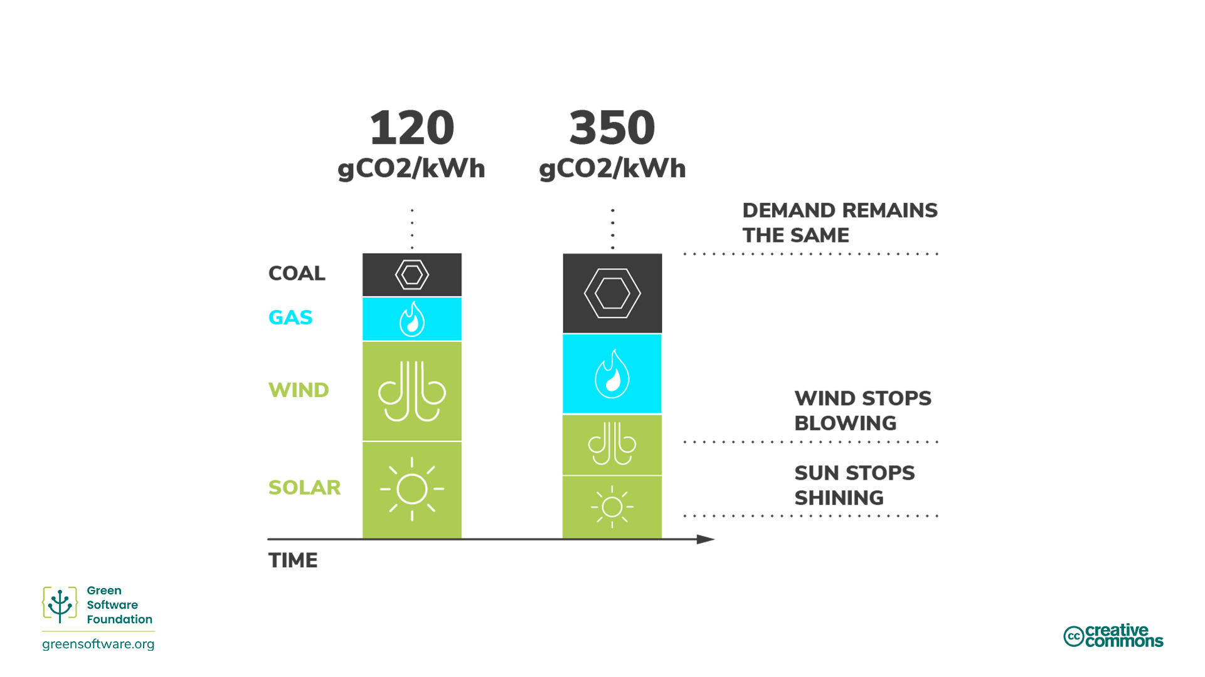

Slide 20
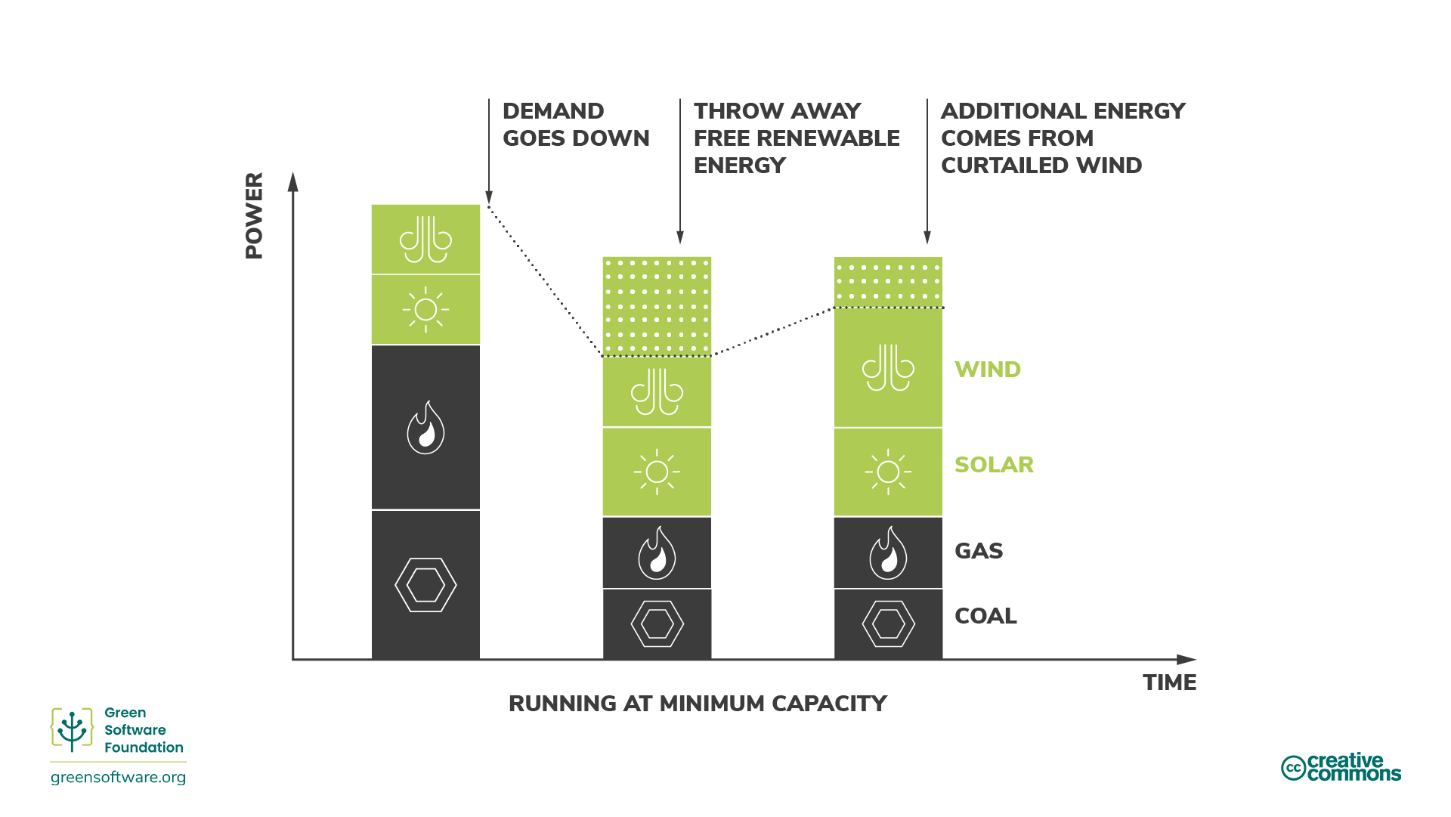

Slide 21


Slide 22
Shifting

Slide 23
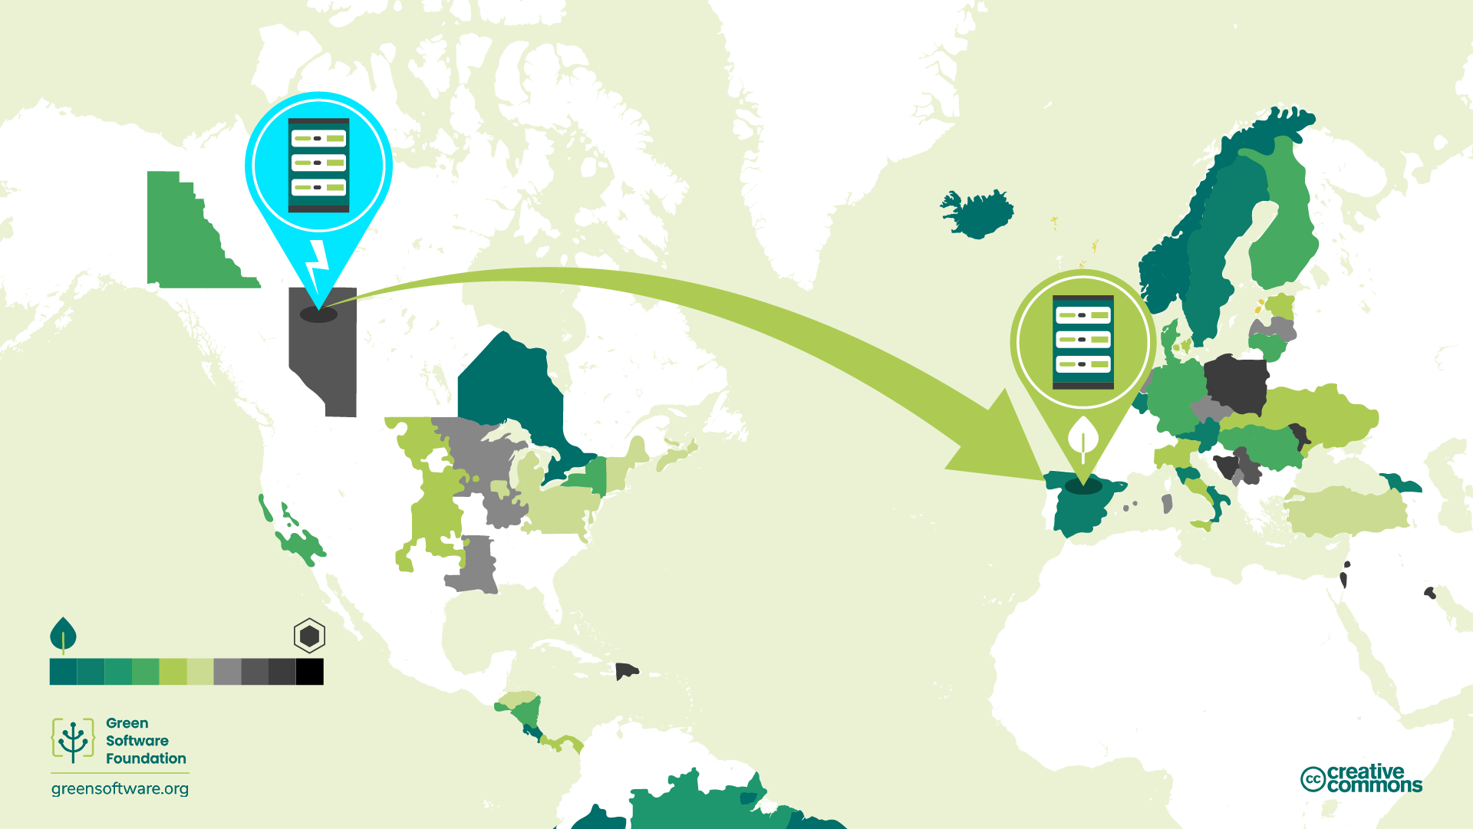

Slide 24
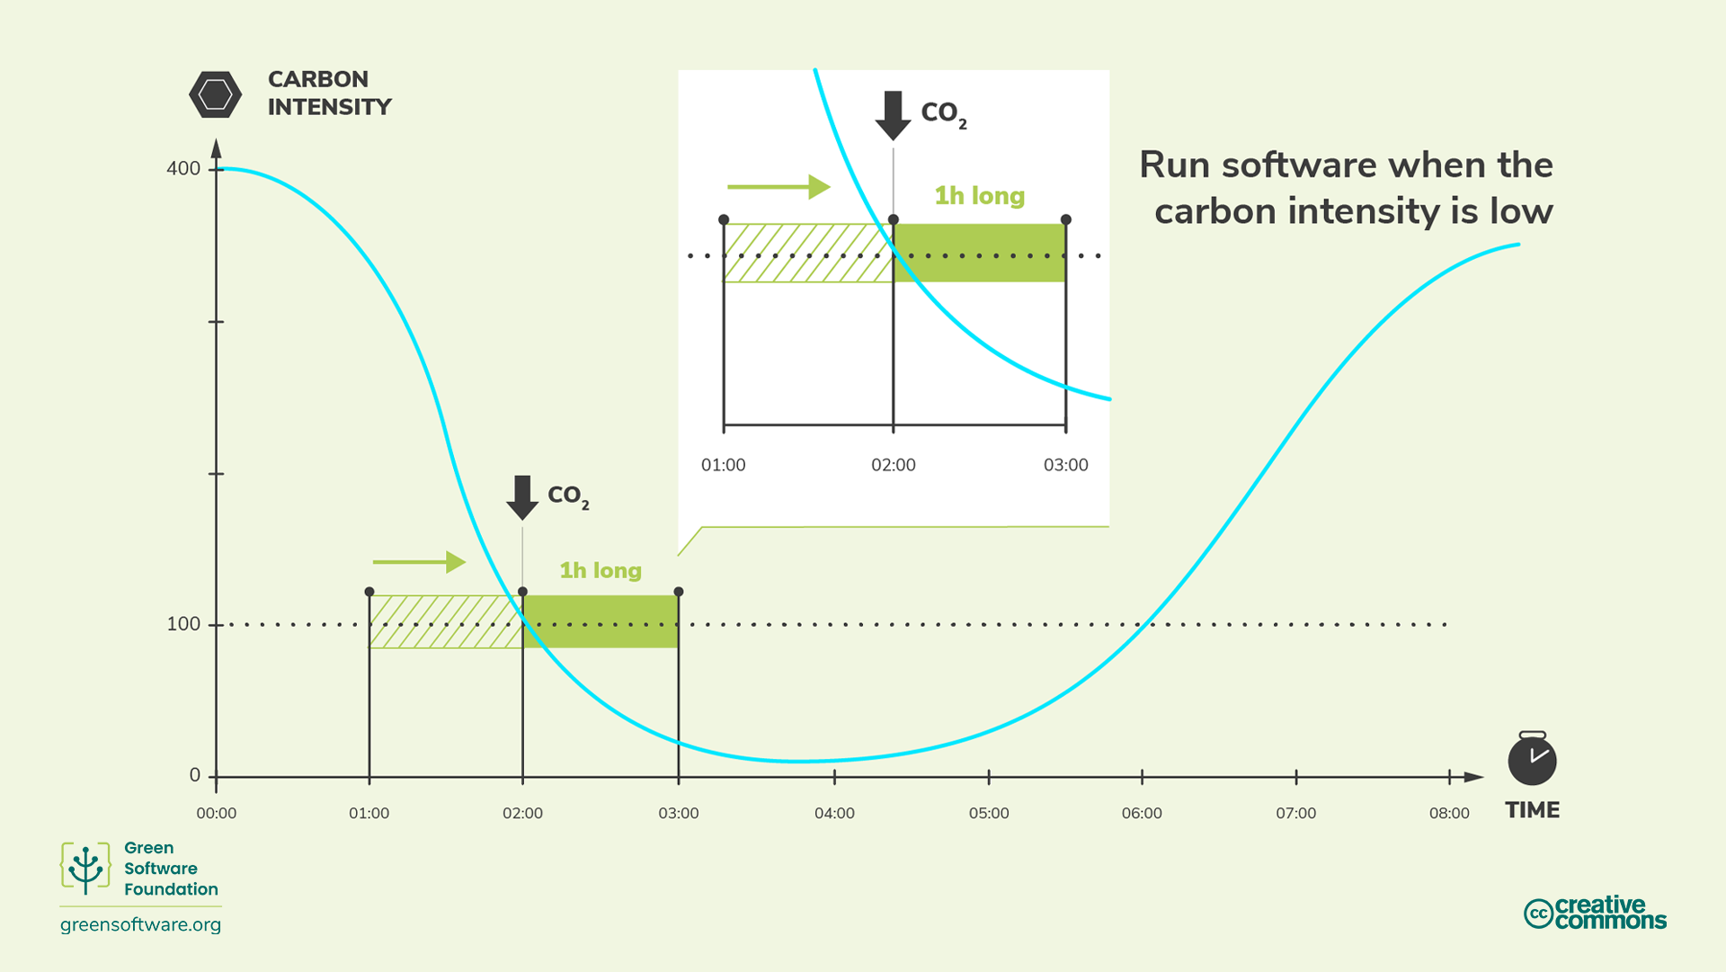

Slide 25
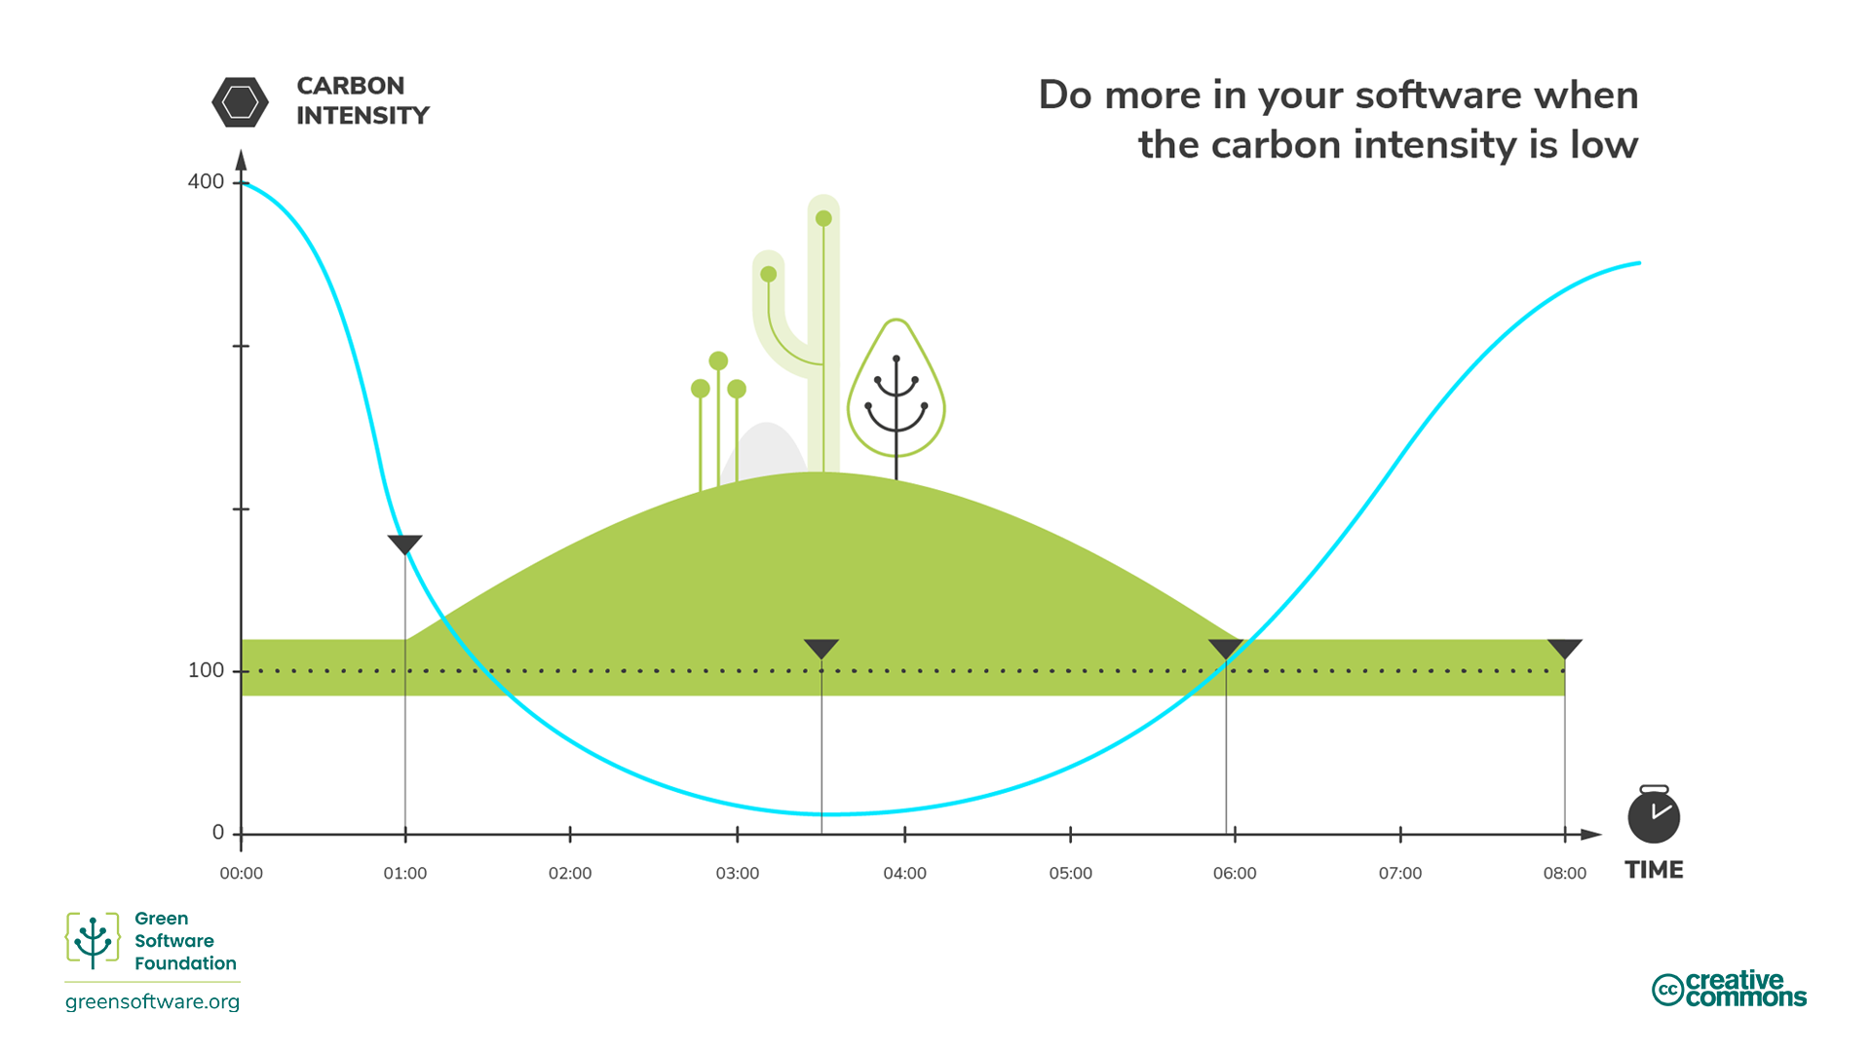

Slide 26
Carbon Neutral vs Net Zero

Slide 27
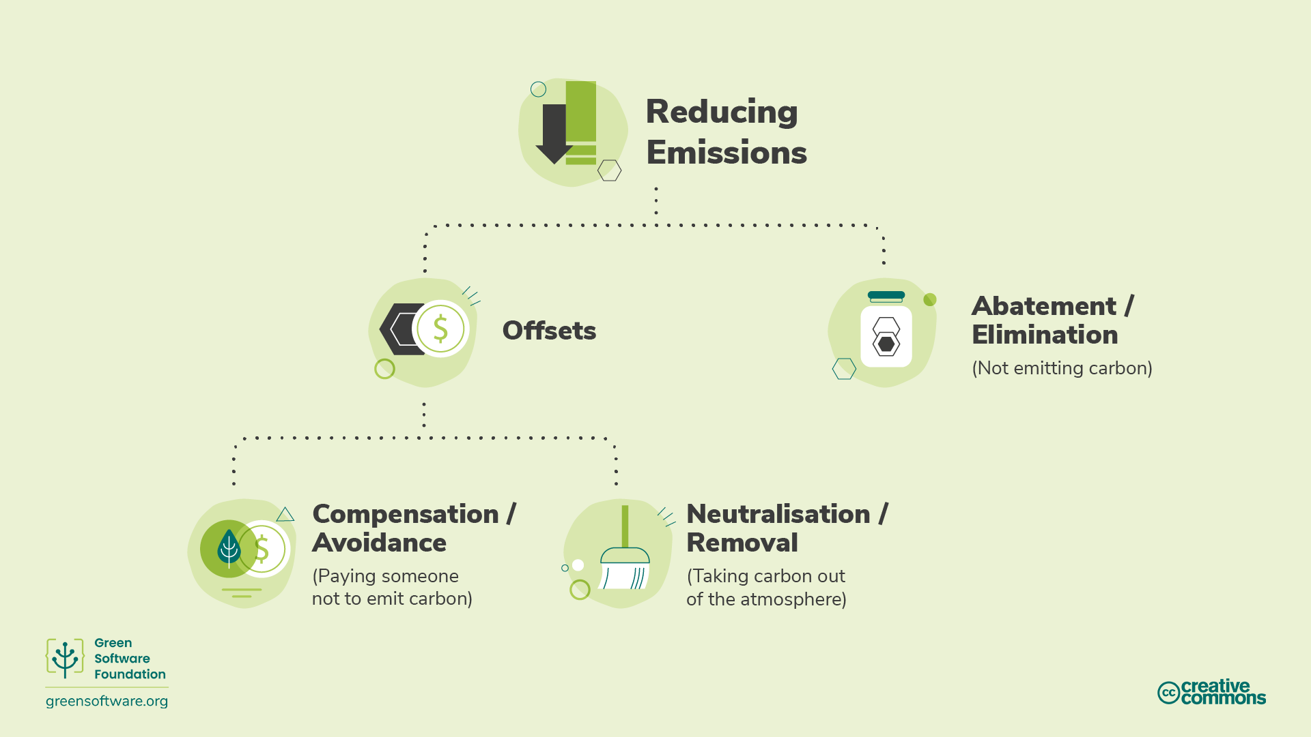

Slide 28
What is the primary goal with abatement/elimination?
ⓘ Start presenting to display the poll results on this slide.

Slide 29
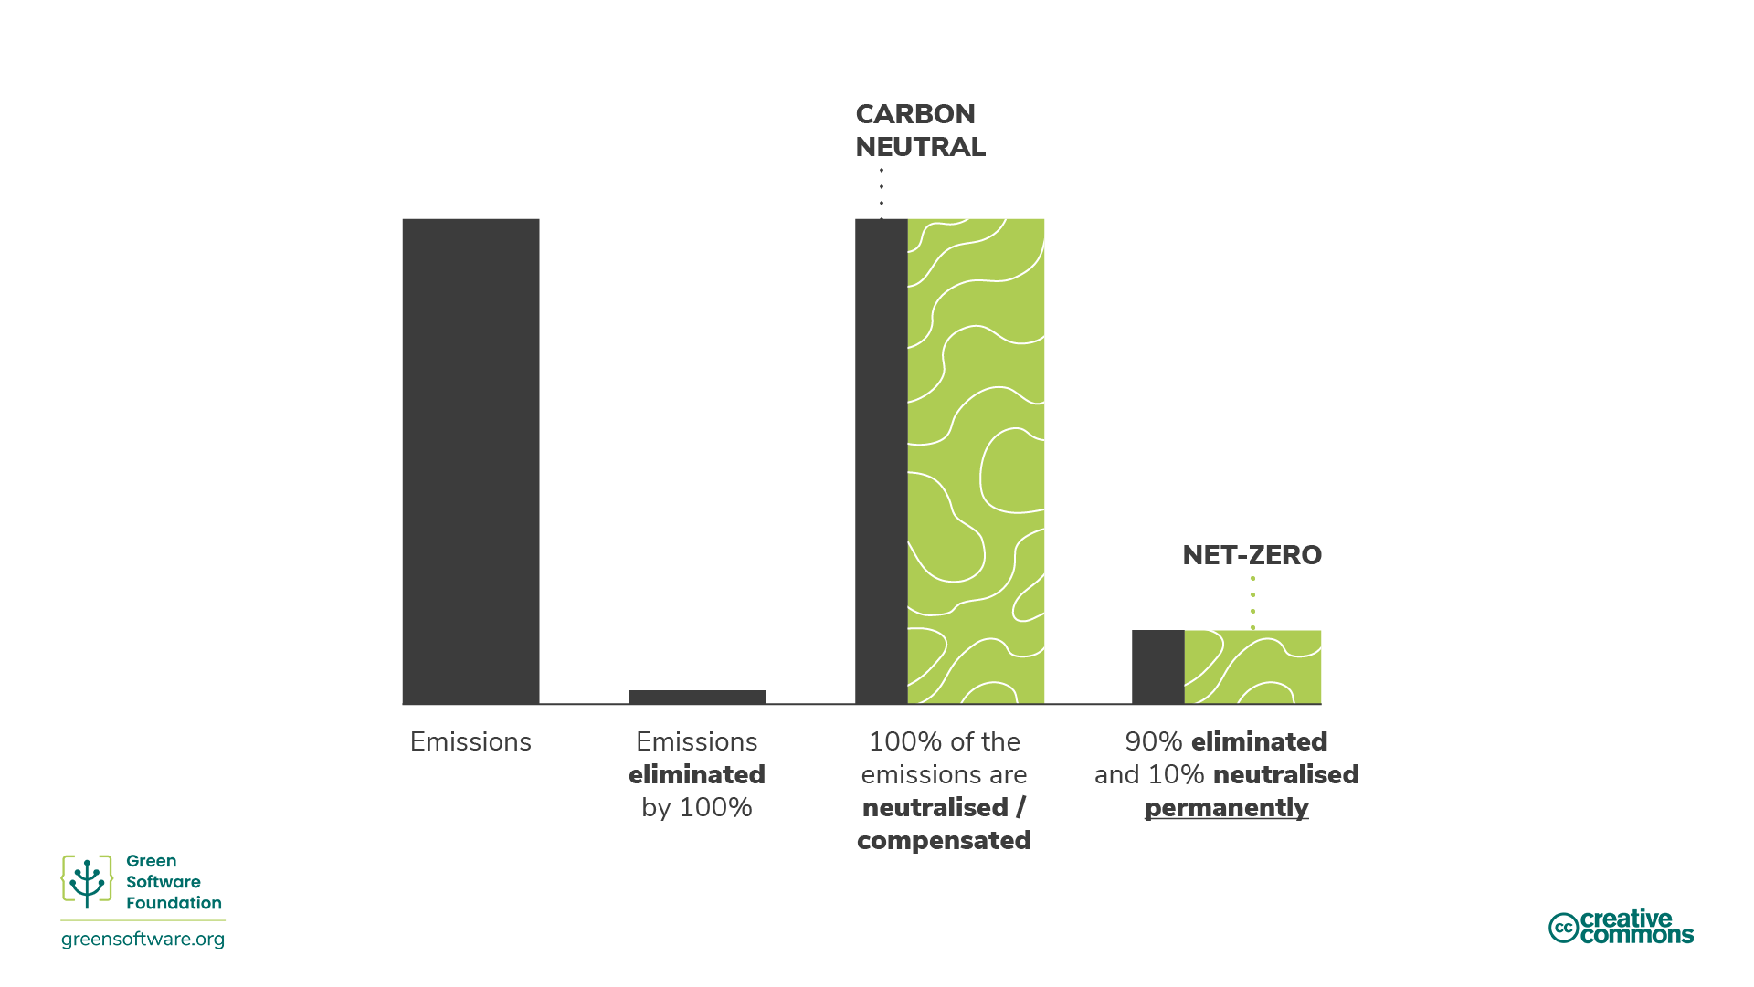

Slide 30
Matching

Slide 31
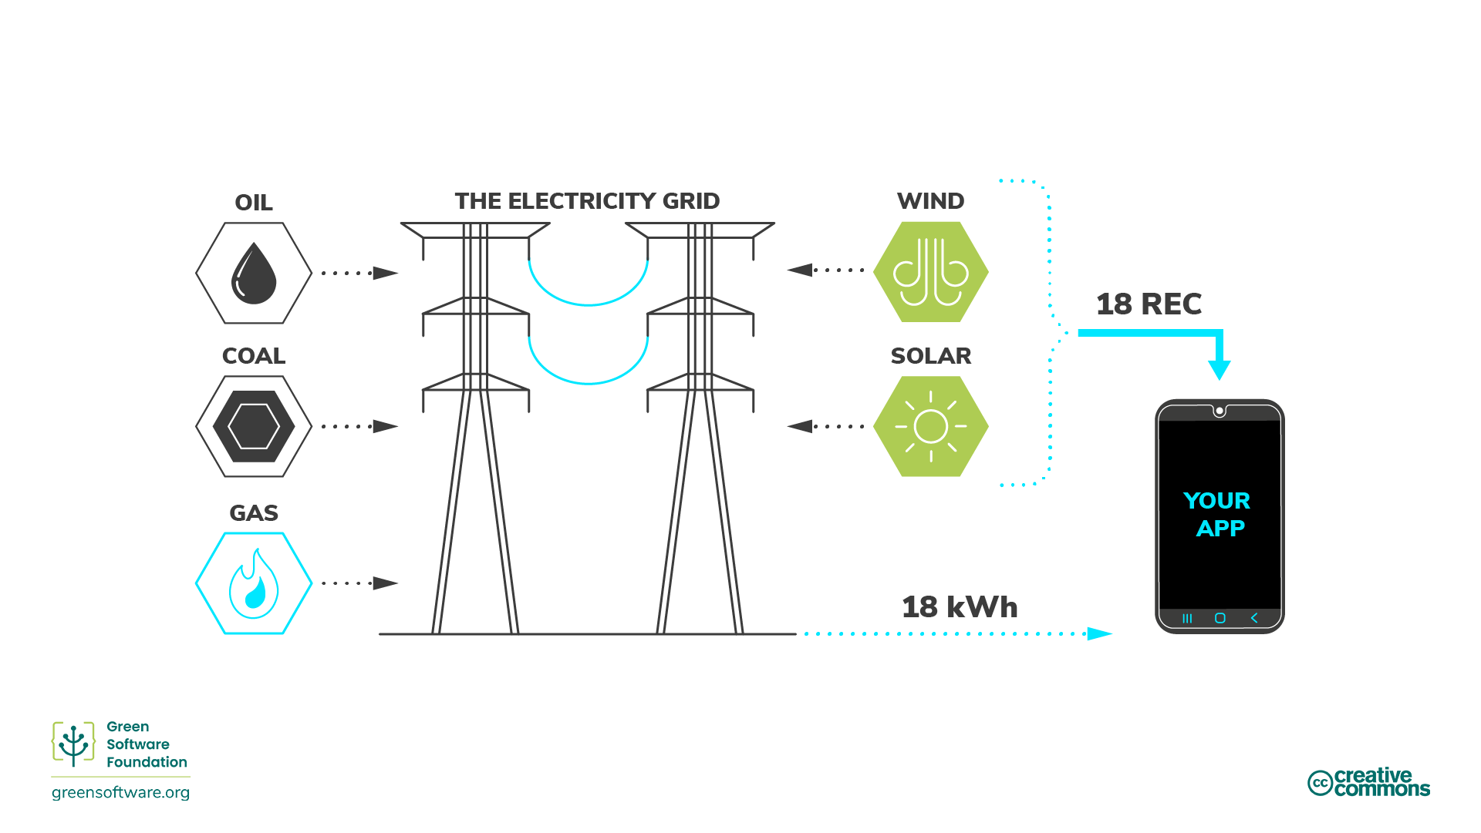

Slide 32


Slide 33
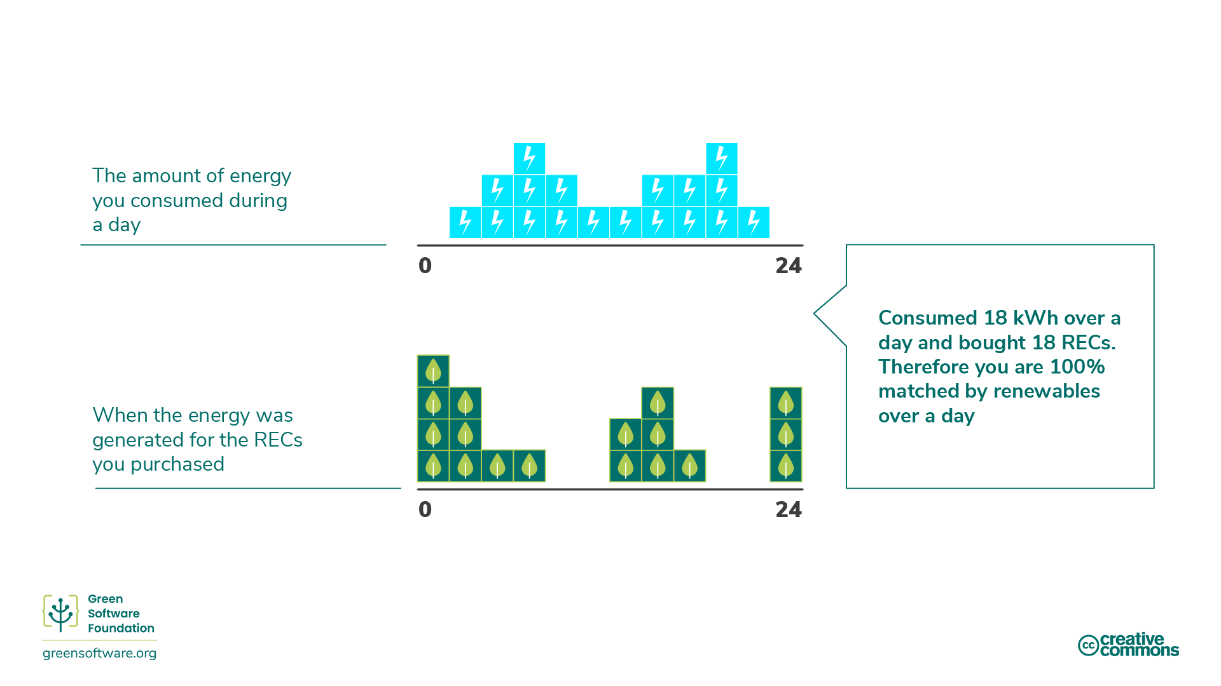

Slide 34
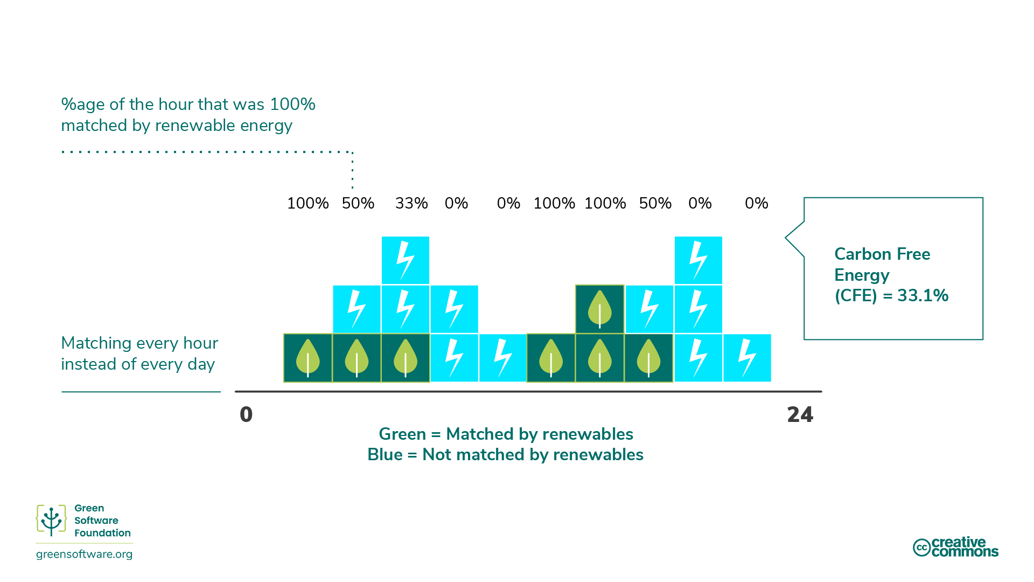

Slide 35
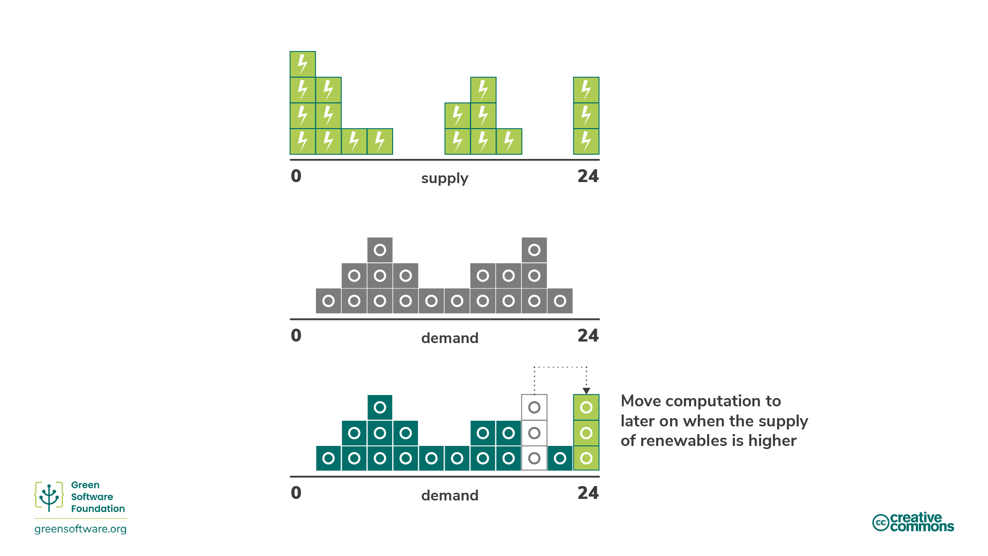

Slide 36
Measurment

Slide 37
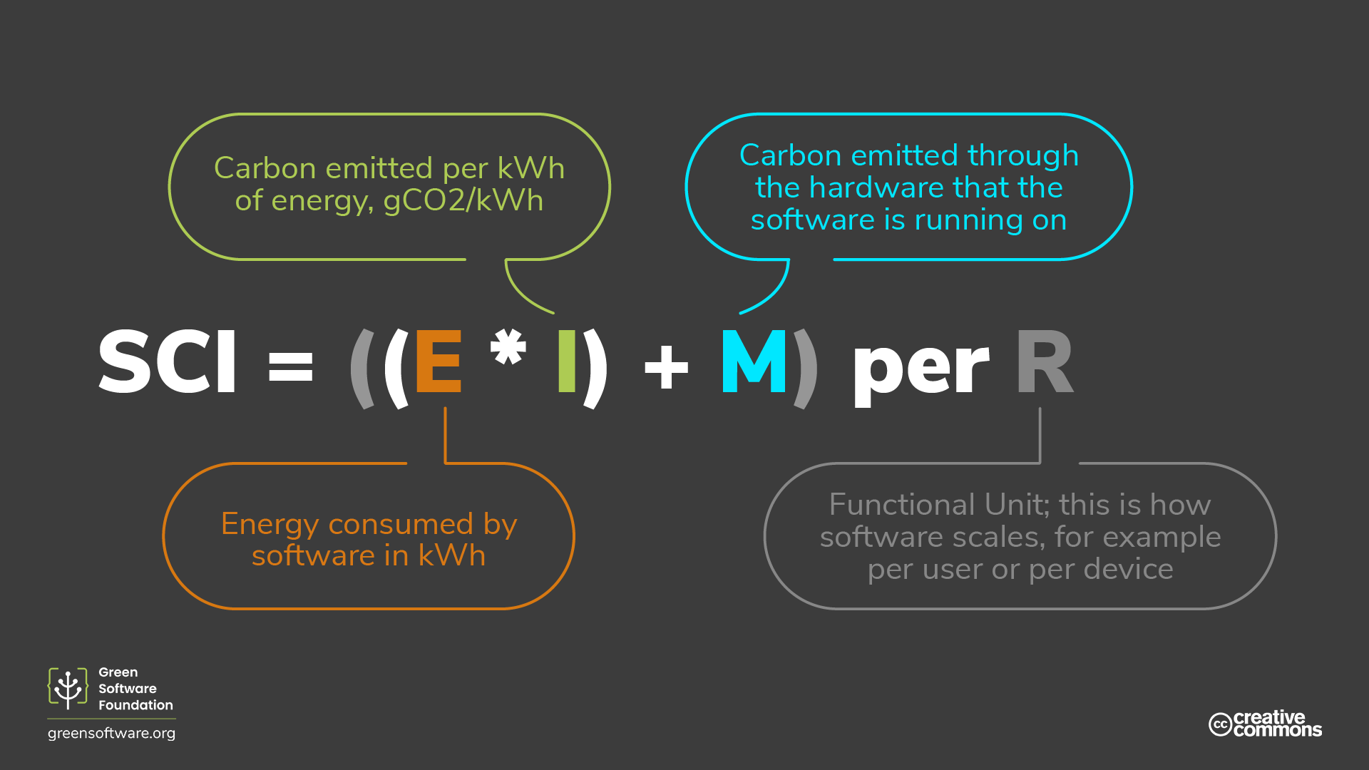

Slide 39
What’s Next

Slide 40

Audience Q&A Session
ⓘ Start presenting to display the audience questions on this slide.

Slide 41

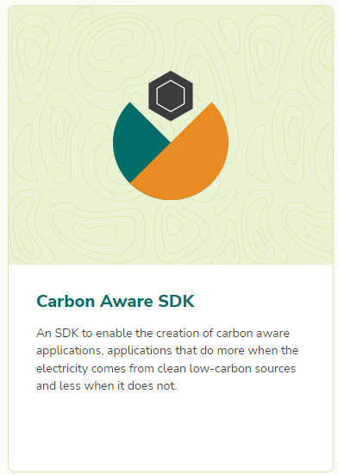


Slide 42

